Slide 1





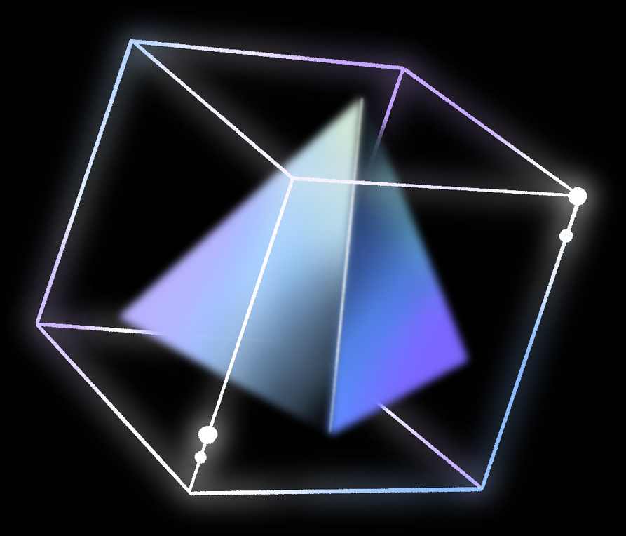
DEVSTREAM

Slide 2
TABLE OF CONTENTS
Introduction
Core Features
Technology Used
Technical Highlights
Future Scope
01
02
03
04
05

Slide 3

INTRODUCTION
DevStream is project that replicates key features and takes inspiration from YouTube. The application is built using React for the front-end, Redux Toolkit for efficient state management, and TailwindCSS for styling, ensuring a modern and responsive design. DevStream offers features such as video listings, real-time search with debouncing, a comments section, and live chat. This project serves as a comprehensive learning tool, demonstrating how to implement advanced front-end development techniques and integrate complex functionalities in a web application.

Slide 4


CORE FEATURES
Video Lists: Displays videos dynamically using API data.
Search Functionality: Real-time search with debouncing and suggestions.
Comments Section: Users can view and add comments.
Live Chat: Real-time chat feature for user interaction.
One-Click Language Filtering: It allows users to filter video content by programming languages with a simple click, instantly displaying relevant videos without needing to type anything.

Slide 5



TECHNOLOGY USED:
React: Front-end library for building user interfaces.
Redux Toolkit: State management for efficient data flow.
TailwindCSS: Utility-first CSS framework for responsive design.
YouTube API: Integration for fetching video data.

Slide 6

TECHNICAL HIHGLIGHTS
01
02
03
Caching: Improves performance by storing search results.
Debouncing: Optimizes API calls during user search input.
Responsive Design: TailwindCSS ensures the app looks great on all devices

Slide 7


FUTURE SCOPE
Advanced User Features: Custom playlists, subscriptions, and personalized profiles.
Enhanced Video Management: Video editing tools, live streaming, and recommendations.
Monetization Options: Ad integration, premium memberships, and crowdfunding.
Community Features: Social sharing, groups, and forums.

Slide 8


THANK YOU!

